Slide 1

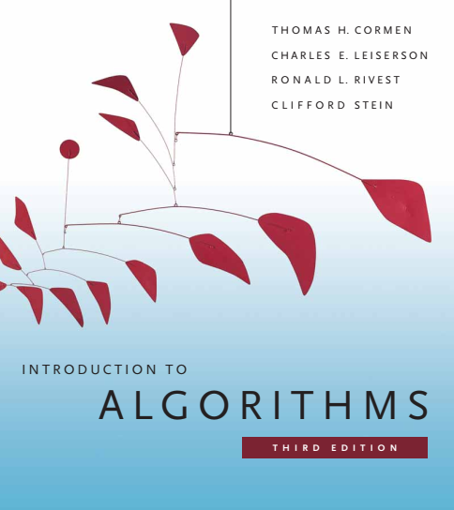
Design and Analysis of Algorithms
Dr. Sajid Iqbal
sajidiqbal.pk@gmail.com
Reference Book
Introduction to Algorithms 3rd Edition By Thomas H. Cormen et. al.
https://mitpress.mit.edu/books/introduction-algorithms-third-edition
COMEDXD

Slide 2
Solving Recursion
Substitution method

Slide 3
Substitution Method
This method works in two steps: Guess and Prove
Guess the form of the solution
Use mathematical induction to find the constants and show that the solution works.
We substitute the guessed solution for the function when applying the inductive hypothesis to smaller values
This method is powerful, but we must be able to guess the form of the answer in order to apply it.
Your experience with algorithms analysis will help you to find the guess of the recurrence.

Slide 4

Example
Let we try to solve the recursion $T\left(n\right)=2T\left(\left\lfloor \frac{n}{2}\right\rfloor \right)+n$
Let, using our previous knowledge we guess the time complexity for this recurrence as $O(n ∗ log n)$
The substitution method requires us to prove that $T(n)≤ cn lg⁡n$for an appropriate choice of the constant $c > 0$
This method is powerful but it is only applicable to instances where the solutions can be guessed

Slide 5

Mathematical induction
A technique for proving a statement to be true
This technique consists of three steps
Initial or base case: prove that statement is true for some base case i.e. $0$ or $1$
Inductive Hypothesis: Suppose that the statement hold (is true) for some case $n$
Induction Step: Prove that the case is also true for $n+1$ case

Slide 6

Substitution Method
Base Case:
We will show that $T\left(n\right)≤ cn\log{n}+n$ works for the boundary conditions as well
This requirement can sometimes lead to problems.
Let us assume that $T(1)=1$is the sole boundary condition of the recurrence
For n=1, $T\left(n\right)≤ cn\log{n}+n$→ $cn 0+1 →0+1 (confusing)$
It is at odds with $T(1)= 1$. The base case of our inductive proof fails to hold

Slide 7


Substitution Method
$$T\left(n\right)=2T\left(\left\lfloor \frac{n}{2}\right\rfloor \right)+n$$
For asymptotic notations, we need to prove $T(n)≤ cn log⁡n$ for some $n>n_{0}$
Instead of using $T(1)$, we try higher input sizes i.e. $T(2), T(3)$
For input 2: $T\left(n\right)≤ cn\log{n}+n→T\left(2\right)≤ c2\log{2}+2 →4$
For input 3: $T\left(n\right)≤ cn\log{n}+n→T\left(3\right)≤ c3\log{3}+2 →5$
So any choice of $n>1$ the condition holds

Slide 8


Substitution Method
$$T\left(n\right)=2T\left(\left\lfloor \frac{n}{2}\right\rfloor \right)+n$$
$$O(n ∗ logn)$$
Inductive Hypothesis: Assume that this bound holds for all positive $m < n$, in particular for $m=\left\lfloor \frac{n}{2}\right\rfloor$, yielding $T\left\lfloor n/2\right\rfloor =c\left\lfloor \frac{n}{2}\right\rfloor log\left\lfloor \frac{n}{2}\right\rfloor$
Inductive Step: Now we substitute it in our recursion
$T(n)≤2T(n/2)+n$
$T\left(n\right)≤2\left[c\left(\frac{n}{2}\right)\log\left(\frac{n}{2}\right)\right]+n→cnlog\left(\frac{n}{2}\right)+n$
$T(n)≤cnlogn – cnlog2+n$
$T\left(n\right)≤ cnlogn – cn+n$
$T\left(n\right)≤ cnlogn$

Slide 9

Making a good guess
Guessing a solution takes experience and, occasionally, creativity
There are multiple ways to have good guess
Try to map complex problem to simple already solved problem
$T(n)=2T(\frac{n}{2}+17)+n$
This recurrence seems difficult as every recursion has added constant i.e. 17
However for large value of n, the contribution of 17 becomes small, hence can be ignored
So we can easily guess it as $O(n logn)$
prove loose upper and lower bounds on the recurrence and then reduce the range of uncertainty
For $T(n)=2T(\frac{n}{2})+n$,
loose lower bound can be $Ω(n)$ and loose upper bound can be $O\left(n^{2}\right)$
Gradually lower the upper bound and raise the lower bound until we converge on the correct, asymptotically tight solution $O(n logn)$

Slide 10

Refinements
Sometimes a good guess is made but somehow the math fails to work out in the induction
Most probable problem in this context is weak inductive assumption
If you revise the guess by subtracting a lower-order term when you hit such a snag, the math often goes through
$T(n)=T(\left\lfloor n/2\right\rfloor )+T(\left\lceil n/2\right\rceil )+1$
Let our guess is $T(n)=O(n)$and we try to prove $T(n)≤ cn$
$T\left(n\right)≤c\left\lfloor \frac{n}{2}\right\rfloor +c\left\lceil \frac{n}{2}\right\rceil +1 →T\left(n\right)≤cn+1$
It is $θ\left(n\right) not O(n)$
We may try $O(n^{2}),$that will work but right guess is $O(n)$ that needs complex mathematics

Slide 11

Refinements
We overcome our difficulty by subtracting a lower-order term from our previous guess
Out new guess is $T(n) ≤cn−d$ where $d≥0$
So the equation is now
$T\left(n\right)=T\left(\left\lfloor \frac{n}{2}\right\rfloor \right)+T\left(\left\lceil \frac{n}{2}\right\rceil \right)+1$
$T(n)≤(c\left\lfloor \frac{n}{2}\right\rfloor −d)+c(\left\lceil \frac{n}{2}\right\rceil −d)+1$
$T\left(n\right)≤cn−2d+1$
$T\left(n\right)≤cn−d$
It is easy to err in the use of asymptotic notations

Slide 12
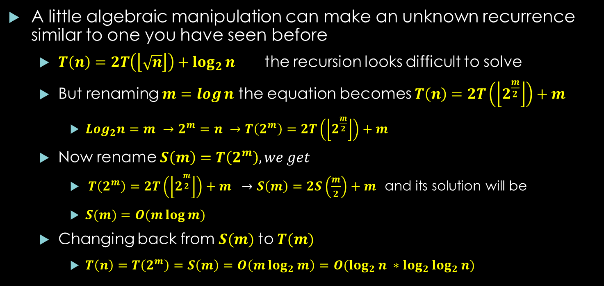
Refinements
A little algebraic manipulation can make an unknown recurrence similar to one you have seen before
$T\left(n\right)=2T\left(\left\lfloor \sqrt{n}\right\rfloor \right)+\log_{2}{n }$ the recursion looks difficult to solve
But renaming $m=log⁡n$ the equation becomes $T\left(n\right)=2T\left(\left\lfloor 2^{\frac{m}{2}}\right\rfloor \right)+m$
$Log_{2}n=m →2^{m}=n →T\left(2^{m}\right)=2T\left(\left\lfloor 2^{\frac{m}{2}}\right\rfloor \right)+m$
Now rename $S\left(m\right)=T\left(2^{m}\right), we get$
$T\left(2^{m}\right)=2T\left(\left\lfloor 2^{\frac{m}{2}}\right\rfloor \right)+m →S\left(m\right)=2S\left(\frac{m}{2}\right)+m$ and its solution will be
$S(m)=O(m\log{m})$
Changing back from $S(m)$to $T(m)$
$T\left(n\right)=T\left(2^{m}\right)=S\left(m\right)=O\left(m\log_{2}{m}\right)=O(\log_{2}{n} ∗\log_{2}{\log_{2}{n}})$

Slide 13
Thanks for watching
Dr. Sajid Iqbal
Assistant Professor
Department of Computer Science
Bahauddin Zakariya University, Multan
Allah Hafiz

